Slide 1
INSURANCE CLAIM
PROJECT
BY: GUTHIREDDY PRAVEEN
INSURANCE CLAIM BUSINESS ANALYSIS

Slide 2
1.Perform the basic Exploratory Data Analysis on the sample data.
AGE
The Average age is around 39.20
Negative Kurtosis gives us a flatter distribution for this variable.
Skewness is nearly 0, which says curve follows normal distribution.
AGE
Mean | 39.20702541
Standard Error | 0.384102419
Median | 39
Mode | 18
Standard Deviation | 14.04996038
Sample Variance | 197.4013867
Kurtosis | -1.245087653
Skewness | 0.055672516
Range | 46
Minimum | 18
Maximum | 64
Sum | 52459
Count | 1338

Slide 3
1.Perform the basic Exploratory Data Analysis on the sample data.
BMI
The Average of BMI is around 30.6
The data gives us slightly negative kurtosis but since the value is
small so we can say it is a Normal distribution.
Skewness of about 0.28 gives a right tailed distribution.
BMI
Mean | 30.66339686
Standard Error | 0.166714232
Median | 30.4
Mode | 32.3
Standard Deviation | 6.098186912
Sample Variance | 37.18788361
Kurtosis | -0.050731531
Skewness | 0.284047111
Range | 37.17
Minimum | 15.96
Maximum | 53.13
Sum | 41027.625
Count | 1338

Slide 4
1.Perform the basic Exploratory Data Analysis on the sample data
CHILDERN
The average no. of children is around 39.
The data gives 0.20 kurtosis but since the value is small so
we can say follows Normal distribution.
Skewness of about 0.93 gives a right tailed distribution.
CHILDREN
Mean | 1.094918
Standard Error | 0.032956
Median | 1
Mode | 0
Standard Deviation | 1.205493
Sample Variance | 1.453213
Kurtosis | 0.202454
Skewness | 0.93838
Range | 5
Minimum | 0
Maximum | 5
Sum | 1465
Count | 1338

Slide 5
1.Perform the basic Exploratory Data Analysis on the sample data
CHARGES
The average charges is around 13270.
Positive Kurtosis gives us a shape curve than normal curve
- saying more values are concentrated near to median.
Skewness of about 1.51 gives a right tailed distribution.
CHARGES($)
Mean | 13270.42227
Standard Error | 331.0674543
Median | 9382.033
Mode | 1639.5631
Standard Deviation | 12110.01124
Sample Variance | 146652372.2
Kurtosis | 1.606298653
Skewness | 1.515879658
Range | 62648.55411
Minimum | 1121.8739
Maximum | 63770.42801
Sum | 17755824.99
Count | 1338

Slide 6
2. Identify the categorical and continuous variables.
Continuous Variables | Categorical Variables
Age | Sex
BMI | Smoker
Charges | Region
Children

Slide 7
 | Column Labels
 | female |  |  | male |  |  | Total Count of smoker | Total Count of bmi | Total Count of charges($)
Row Labels | Count of smoker | Count of bmi | Count of charges($) | Count of smoker | Count of bmi | Count of charges($)
northeast | 161 | 161 | 161 | 163 | 163 | 163 | 324 | 324 | 324
northwest | 164 | 164 | 164 | 161 | 161 | 161 | 325 | 325 | 325
southeast | 175 | 175 | 175 | 189 | 189 | 189 | 364 | 364 | 364
southwest | 162 | 162 | 162 | 163 | 163 | 163 | 325 | 325 | 325
Grand Total | 662 | 662 | 662 | 676 | 676 | 676 | 1338 | 1338 | 1338

Slide 8
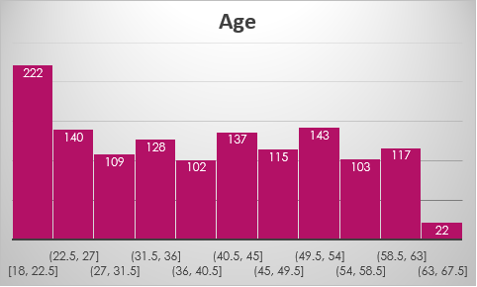
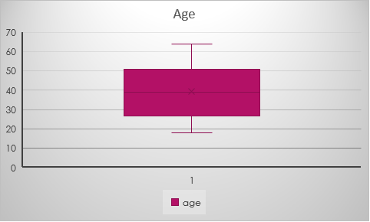
3. Make Histograms and box plots for Continuous Variables, do a Correlation analysis
AGE

Slide 9
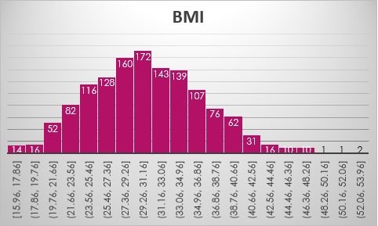
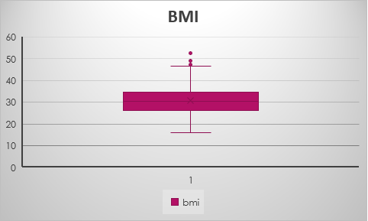
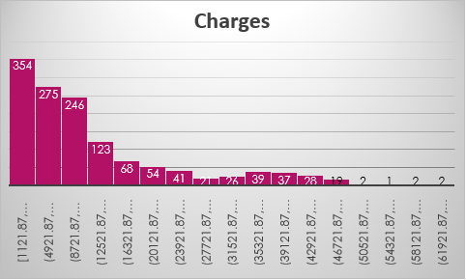
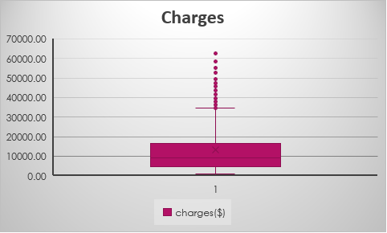

Slide 10
CORRELATION ANALYSIS
 | BMI | CHILDREN | CHARGES($) | AGE
BMI | 1
CHILDREN | 0.012759 | 1
CHARGES($) | 0.198341 | 0.067998 | 1
AGE | 0.109272 | 0.042469 | 0.299008 | 1

Slide 11
4. Make relevant Pivot tables and charts for:
Male/Female ratio & which gender has more smokers
Row Labels | Count of smoker
female | 662
male | 676
Grand Total | 1338

Slide 12
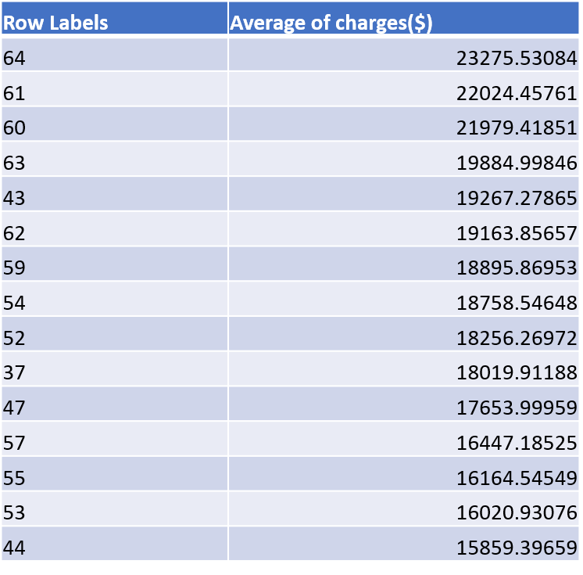
CHARGES VS AGES

Slide 13
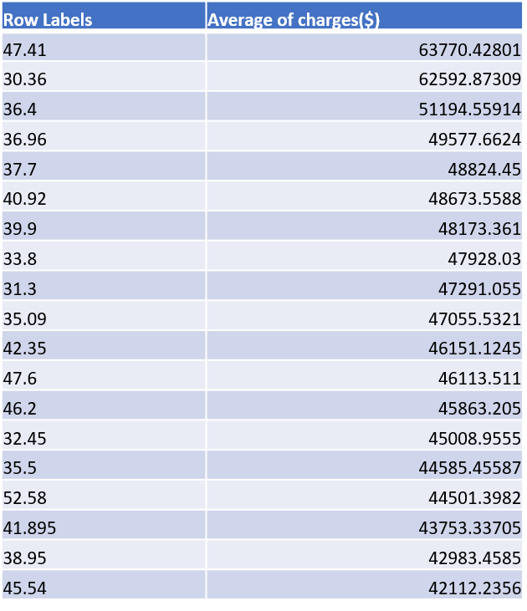
CHARGES VS BMI

Slide 14
CHARGES FOR SMOKERS VS NON-SMOKERS
Row Labels | Average of charges($)
no | 8434.268298
yes | 32050.23183
Grand Total | 13270.42227

Slide 15
5.Region-Wise Smokers vs Non-Smokers analysis with one or more pivot table & charts
Count of smoker | Column Labels
Row Labels | no | yes | Grand Total
northeast | 257 | 67 | 324
northwest | 267 | 58 | 325
southeast | 273 | 91 | 364
southwest | 267 | 58 | 325
Grand Total | 1064 | 274 | 1338

Slide 16
6. Region-Wise Charges for smokers vs non-smokers
Average of charges($) | Column Labels
Row Labels | no | yes | Grand Total
northeast | 9165.531672 | 29673.53647 | 13406.38452
northwest | 8556.463715 | 30192.00318 | 12417.57537
southeast | 8032.216309 | 34844.99682 | 14735.41144
southwest | 8019.284513 | 32269.06349 | 12346.93738
Grand Total | 8434.268298 | 32050.23183 | 13270.42227

Slide 17
7.Has Charges got something to do with no. of dependants?
Row Labels | Average of charges($)
0 | 12365.9756
1 | 12731.17183
2 | 15073.56373
3 | 15355.31837
4 | 13850.65631
5 | 8786.035247
Grand Total | 13270.42227

Slide 18
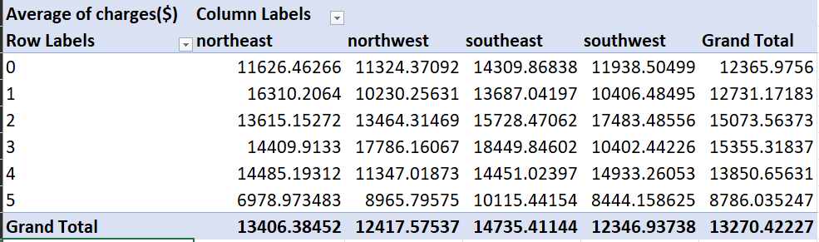
8. Do a similar dependants-charges analysis, Region-Wise.

Slide 19
9) Do at least one more pivot table and chart of your own choice, if needed
  Give your understanding from the patterns observed in point (b)
  Give your interpretation for observations made in point ( c )
  Edit the data as following, to obtain dummy variables:
  Sex : Replace all the “Males” with “1” and “Females” with “0”, creating numerical entries for gender this way will help you do analysis further. You can use Replace with “Match entire cell content option. Do a replace all to save time.
  Smoker: Replace all the “Smokers” with “1” and “Non-smokers” with “0”.
  Region: We always create one less category column for the dummy data w.r.t the categories available for that original variable. So for Region, we will create three dummy columns, assuming “Northeast” as zero and omit the column for it. Now create three columns for “northwest”, “Southeast”, “Southwest”. Whichever row has “northwest” region as an entry will take “1” as an entry otherwise “0” in “northwest” column. Similarily in “Southeast” column, which ever row had “southeast” as an entry will take “1” as the new entry and “0” for the rest columns. Do a similar operation on “Southwest” column.

Slide 20
age | sex | bmi | children | smoker | northwest | southest | southwest | charges($)
19 | 0.00 | 27.9 | 0 | 1.00 | 0.00 | 0.00 | 1.00 | 16884.92
18 | 1.00 | 33.77 | 1 | 0.00 | 0.00 | 1.00 | 0.00 | 1725.55
28 | 1.00 | 33 | 3 | 0.00 | 0.00 | 1.00 | 0.00 | 4449.46
33 | 1.00 | 22.705 | 0 | 0.00 | 1.00 | 0.00 | 0.00 | 21984.47
32 | 1.00 | 28.88 | 0 | 0.00 | 1.00 | 0.00 | 0.00 | 3866.86
31 | 0.00 | 25.74 | 0 | 0.00 | 0.00 | 1.00 | 0.00 | 3756.62
46 | 0.00 | 33.44 | 1 | 0.00 | 0.00 | 1.00 | 0.00 | 8240.59
37 | 0.00 | 27.74 | 3 | 0.00 | 1.00 | 0.00 | 0.00 | 7281.51
37 | 1.00 | 29.83 | 2 | 0.00 | 0.00 | 0.00 | 0.00 | 6406.41
60 | 0.00 | 25.84 | 0 | 0.00 | 1.00 | 0.00 | 0.00 | 28923.14
25 | 1.00 | 26.22 | 0 | 0.00 | 0.00 | 0.00 | 0.00 | 2721.32
62 | 0.00 | 26.29 | 0 | 1.00 | 0.00 | 1.00 | 0.00 | 27808.73
23 | 1.00 | 34.4 | 0 | 0.00 | 0.00 | 0.00 | 1.00 | 1826.84
56 | 0.00 | 39.82 | 0 | 0.00 | 0.00 | 1.00 | 0.00 | 11090.72
27 | 1.00 | 42.13 | 0 | 1.00 | 0.00 | 1.00 | 0.00 | 39611.76
19 | 1.00 | 24.6 | 1 | 0.00 | 0.00 | 0.00 | 1.00 | 1837.24
52 | 0.00 | 30.78 | 1 | 0.00 | 0.00 | 0.00 | 0.00 | 10797.34
23 | 1.00 | 23.845 | 0 | 0.00 | 0.00 | 0.00 | 0.00 | 2395.17
56 | 1.00 | 40.3 | 0 | 0.00 | 0.00 | 0.00 | 1.00 | 10602.39
30 | 1.00 | 35.3 | 0 | 1.00 | 0.00 | 0.00 | 1.00 | 36837.47
60 | 0.00 | 36.005 | 0 | 0.00 | 0.00 | 0.00 | 0.00 | 13228.85
30 | 0.00 | 32.4 | 1 | 0.00 | 0.00 | 0.00 | 1.00 | 4149.74
18 | 1.00 | 34.1 | 0 | 0.00 | 0.00 | 1.00 | 0.00 | 1137.01
34 | 0.00 | 31.92 | 1 | 1.00 | 0.00 | 0.00 | 0.00 | 37701.88
37 | 1.00 | 28.025 | 2 | 0.00 | 1.00 | 0.00 | 0.00 | 6203.90
59 | 0.00 | 27.72 | 3 | 0.00 | 0.00 | 1.00 | 0.00 | 14001.13
63 | 0.00 | 23.085 | 0 | 0.00 | 0.00 | 0.00 | 0.00 | 14451.84
55 | 0.00 | 32.775 | 2 | 0.00 | 1.00 | 0.00 | 0.00 | 12268.63
23 | 1.00 | 17.385 | 1 | 0.00 | 1.00 | 0.00 | 0.00 | 2775.19
31 | 1.00 | 36.3 | 2 | 1.00 | 0.00 | 0.00 | 1.00 | 38711.00
22 | 1.00 | 35.6 | 0 | 1.00 | 0.00 | 0.00 | 1.00 | 35585.58
18 | 0.00 | 26.315 | 0 | 0.00 | 0.00 | 0.00 | 0.00 | 2198.19
19 | 0.00 | 28.6 | 5 | 0.00 | 0.00 | 0.00 | 1.00 | 4687.80
63 | 1.00 | 28.31 | 0 | 0.00 | 1.00 | 0.00 | 0.00 | 13770.10
28 | 1.00 | 36.4 | 1 | 1.00 | 0.00 | 0.00 | 1.00 | 51194.56
19 | 1.00 | 20.425 | 0 | 0.00 | 1.00 | 0.00 | 0.00 | 1625.43
62 | 0.00 | 32.965 | 3 | 0.00 | 1.00 | 0.00 | 0.00 | 15612.19
26 | 1.00 | 20.8 | 0 | 0.00 | 0.00 | 0.00 | 1.00 | 2302.30
35 | 1.00 | 36.67 | 1 | 1.00 | 0.00 | 0.00 | 0.00 | 39774.28
60 | 1.00 | 39.9 | 0 | 1.00 | 0.00 | 0.00 | 1.00 | 48173.36
24 | 0.00 | 26.6 | 0 | 0.00 | 0.00 | 0.00 | 0.00 | 3046.06
31 | 0.00 | 36.63 | 2 | 0.00 | 0.00 | 1.00 | 0.00 | 4949.76
41 | 1.00 | 21.78 | 1 | 0.00 | 0.00 | 1.00 | 0.00 | 6272.48
37 | 0.00 | 30.8 | 2 | 0.00 | 0.00 | 1.00 | 0.00 | 6313.76

Slide 21
10) Do a descriptive summary analysis for the edited data. Perform a Multiple Linear Regression analysis to identify which variables decide the insurance charges/billed insurance claim.
Give your interpretation for the above analysis, do another set of regression analysis by dropping insignificant variables, if needed.

Slide 22
SUMMARY OUTPUT
Regression Statistics
Multiple R | 0.866552
R Square | 0.750913
Adjusted R Square | 0.749414
Standard Error | 6062.102
Observations | 1338
ANOVA
 | df | SS | MS | F | Significance F
Regression | 8 | 1.47E+11 | 1.84E+10 | 500.8107 | 0
Residual | 1329 | 4.88E+10 | 36749084
Total | 1337 | 1.96E+11
 | Coefficients | Standard Error | t Stat | P-value | Lower 95% | Upper 95% | Lower 95.0% | Upper 95.0%
Intercept | -11938.5 | 987.8192 | -12.0858 | 5.58E-32 | -13876.4 | -10000.7 | -13876.4 | -10000.7
age | 256.8564 | 11.89885 | 21.58666 | 7.78E-89 | 233.5138 | 280.1989 | 233.5138 | 280.1989
sex | -131.314 | 332.9454 | -0.3944 | 0.693348 | -784.47 | 521.8416 | -784.47 | 521.8416
bmi | 339.1935 | 28.59947 | 11.86013 | 6.5E-31 | 283.0884 | 395.2985 | 283.0884 | 395.2985
children | 475.5005 | 137.8041 | 3.450555 | 0.000577 | 205.1633 | 745.8378 | 205.1633 | 745.8378
smoker | 23848.53 | 413.1534 | 57.7232 | 0 | 23038.03 | 24659.04 | 23038.03 | 24659.04
northwest | -352.964 | 476.2758 | -0.74109 | 0.458769 | -1287.3 | 581.3704 | -1287.3 | 581.3704
southest | -1035.02 | 478.6922 | -2.16219 | 0.030782 | -1974.1 | -95.9473 | -1974.1 | -95.9473
southwest | -960.051 | 477.933 | -2.00876 | 0.044765 | -1897.64 | -22.4656 | -1897.64 | -22.4656

